Slide 1
Application of Induction Machine U/f control through the educational laboratory setup
7th International Scientific Conference Technics and Informatics in Education – TIE2018 Faculty of Technical Sciences, Čačak, Serbia, 25-27th May 2018
Marko Rosić, Miroslav Bjekić and Marko Šućurović
University of Kragujevac, Faculty of Technical Sciences Čačak, Serbia
Email: marko.rosic@ftn.kg.ac.rs
http://www.empr.ftn.kg.ac.rs/

Slide 2
INTRODUCTION
U/f control is a long expected AC machine control technique due to lack of power electronics until the late sixties of the 20th century
Very simple and popular control technique and most represented in modern power converter and drives
Celebrating the half a century since first world commercial frequency converter was lunched in 1968 – Danfoss VLT5
Rapid Control Prototyping as a technique which allows quick development and testing different control algorithms
In this paper a developed laboratory educational setup for U/f control of Induction Machine with experimental results will be described in detail

Slide 3
BACKGROUND THEORY OF U/F CONTROL
U/f control belongs to the group of scalar control methods.
U/f method involves changing the voltage and frequency of the power supply of an AC machine without affecting their phase position at the moment.
Figure 1. U/f characteristic of freq. converter

Slide 4
BACKGROUND THEORY OF U/F CONTROL
Machine stator flux is determined by machine voltage, frequency and in smaller sense by voltage drop on stator resistance according to:
Figure 2. Mechanical characteristic of IM

Slide 5
DESCRIPTION OF LABORATORY SETUP BASED ON DSPACE1104 PLATFORM
The following resources od dSPACE1104 board are utilized in the setup:
PWM control unit
2*A/D converters for current measurement
1*A/D converter for DC voltage measurement
INC unit for measuring the motor speed
The laboratory setup on which scalar U/f control was implemented besides dSPACE1104 board consists of following parts:
Isolated power supply
3-ph power converter (inverter) up to 1 kW
2 current sensors CMS3005
Signal conditioning and isolation board
Isolated DC power supply
IM with encoder
PC with ControlDesk software installed

Slide 6
DESCRIPTION OF LABORATORY SETUP BASED ON DSPACE1104 PLATFORM
Figure 4. Block structure of the laboratory setup

Slide 7
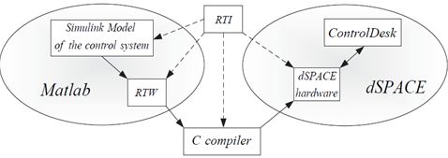
dSPACE1104 DSP board
dSPACE 1104 is a complete real-time control system based on a 603 PowerPC 64-bit floating-point processor running at 250 MHz,
dSPACE platform has enabled communication with models created in the MATLAB/Simulink environment,
Simulink model can be converted to a code suitable for dSPACE processor that further, in real time, controls the application or I/O units.
Figure 3. MATLAB – dSPACE communication

Slide 8
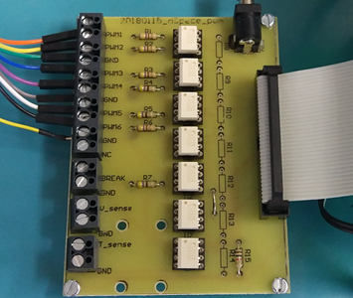
Signal conditioning and isolation board
Isolation board consist of seven TLP2200 optocouplers which unlike the majority of standard commercial optocouplers provide positive logic i.e. output signal with the same polarity as the input signal.
The maximal switching speed depends on the optocoupler bandwidth which is 2.5 MBd.
Measured results show that the board transition time for rising edge (turn on) is 250 ns and for falling edge (turn off) is 400ns.
Figure 5. (a) Signal conditioning and isolation board

Slide 9
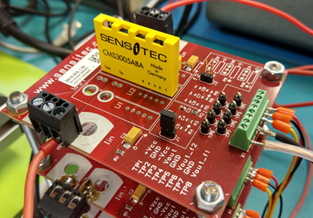
Current measurement
Used for current measurement in two motor phases
Designed for highly dynamic electronic measurement of DC, AC, pulsed and mixed currents with integrated galvanic isolation
CMS3005 has very high dynamic response (bandwidth up to 2 MHz) without the hysteresis
This type of sensors is particularly suitable for high dynamics current measurement application such as in AC electric drives
Figure 5. (b) Currents sensors board

Slide 10
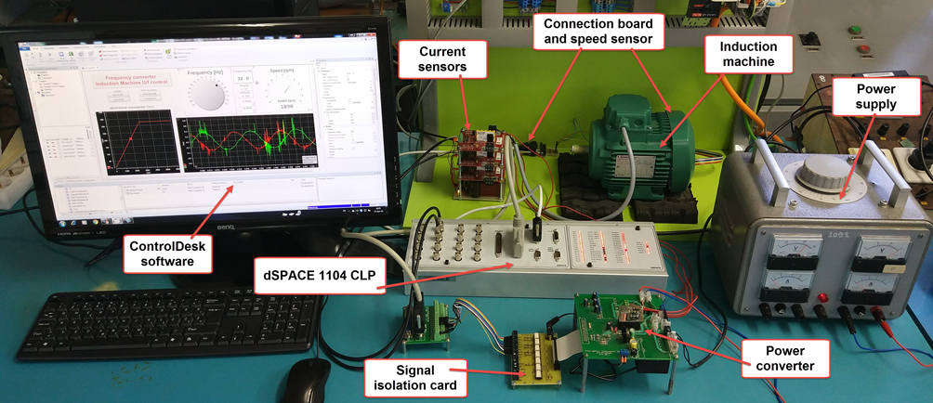
Figure 6. Complete experimental laboratory setup for testing different AC machine control algorithms

Slide 11
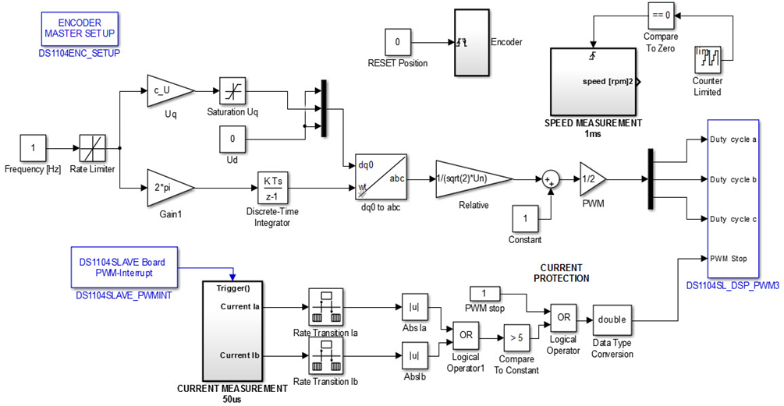
APPLICATION OF U/F CONTROL OF IM
Calculation of stator voltages
Figure 8. Complete Simulink model of the U/f control algorithm

Slide 12
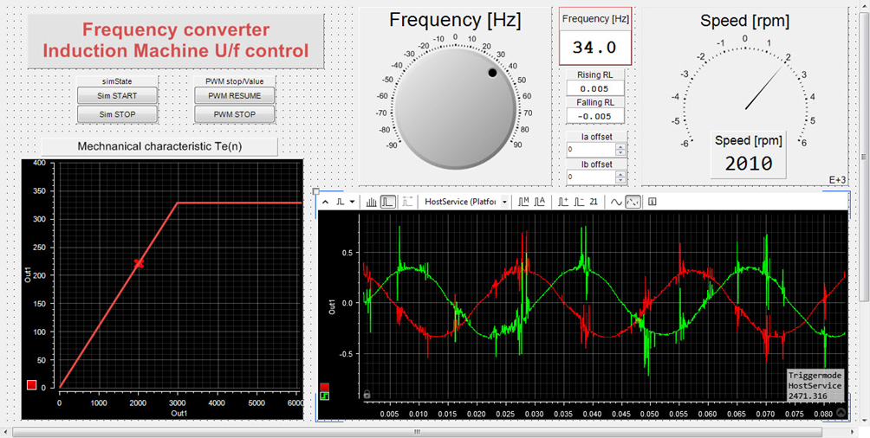
APPLICATION OF U/F CONTROL OF IM
Figure 9. GUI for U/f control of IM

Slide 13
CONCLUSION
The laboratory setup is dedicated to students who follow the course of Control of Electric Drives and should aim for them to gain knowledge and practical skills in the laboratory. This laboratory setup allows its users to perceive all aspects of an AC machine control method in modern electric drive applications such as:
Current and speed measurement and regulation
Implementation of necessary matrix (Clarke and Park) transformations
Determination of the necessary voltage and current references and PWM generation
Flux estimation techniques
Protection implementation
2Q or 4Q machine operation, etc.

Slide 14
Thank you for the attention
Questions?

